Slide 1
Counters
A counter is a special type of finite state machine.
A counter will traverse the states within a state diagram in a linear fashion continually circling around all states.
This behavior allows a special type of output topology called state-encoded outputs.
Since each state in the counter represents a unique counter output, the states can be encoded with the associated counter output value.
In this way, the current state code of the machine can be used as the output of the entire system.

Slide 2
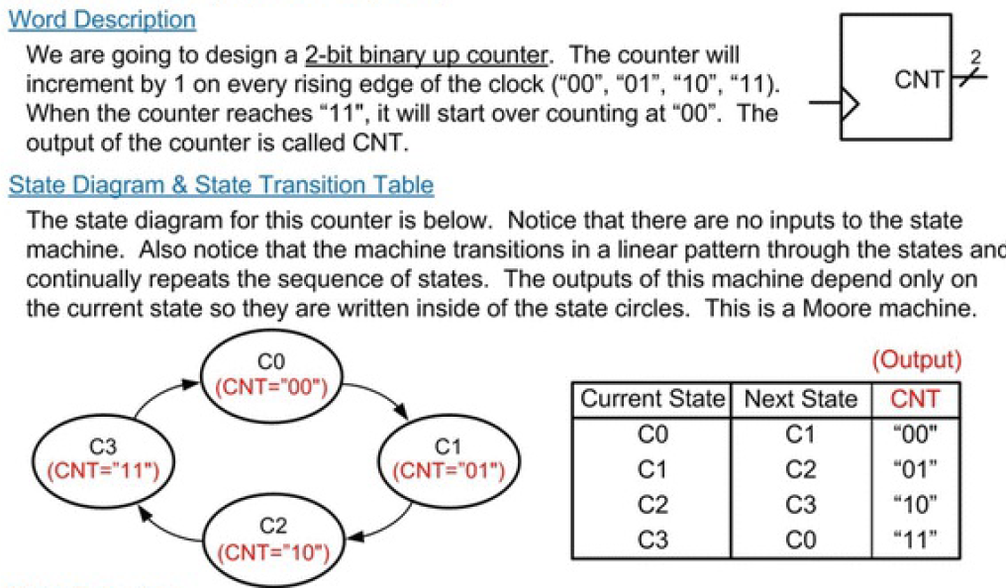
2-Bit Binary Up Counter

Slide 3
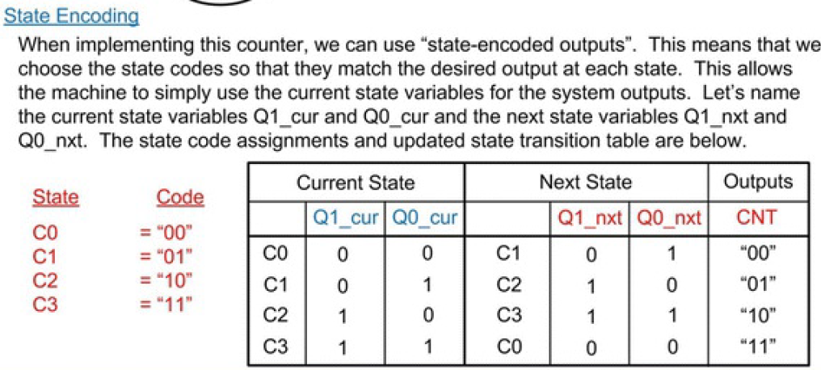
2-Bit Binary Up Counter

Slide 4
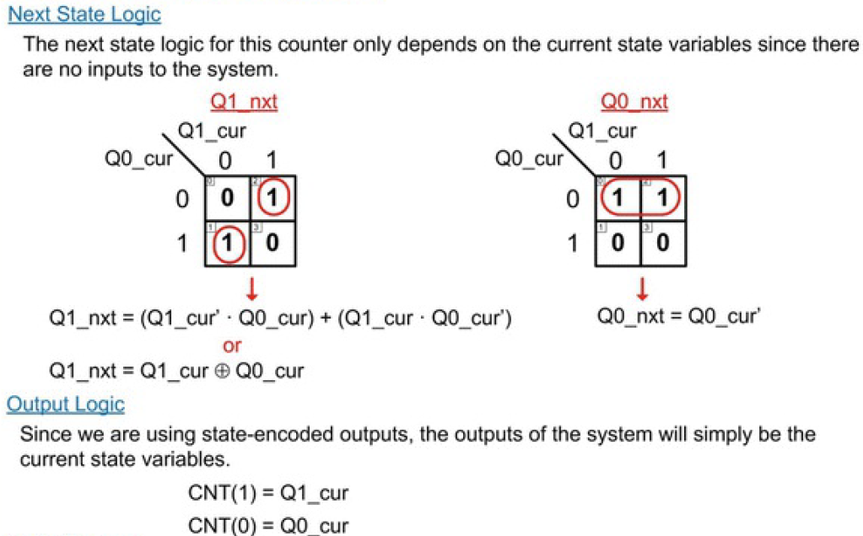
2-Bit Binary Up Counter

Slide 5
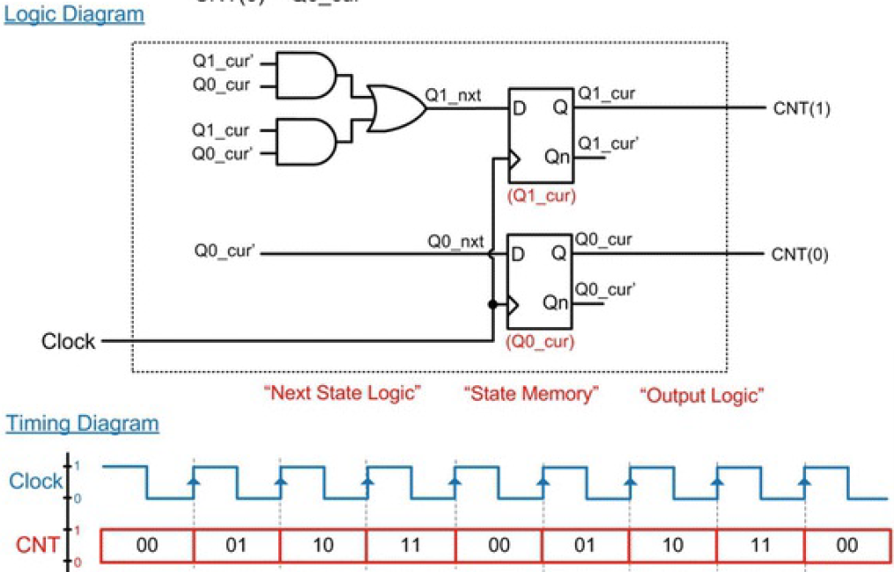
2-Bit Binary Up Counter

